Slide 1
STOCK PRICE PREDICTION

Slide 2
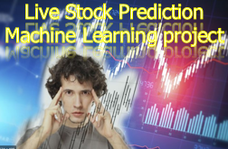
CONTENT
Introduction
Stock Market
Stock Market Prediction
Linear Regression
Discussion
Result
Conclusion
Future Work
References

Slide 3
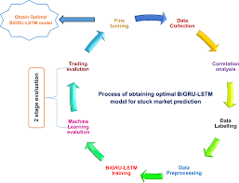
ABSTRACT
Demand of Stock have become huge with Increased in popularity of Stock in Digital world. Prediction and Analysing stock can benefit People to think before buying or selling stocks. So, A New Stock Price Prediction through Deep Learning Algorithms has been analysed and visualized. Through This System we can predict of any Company stock in the world.

Slide 4
INTRODUCTION
It begins with an introduction to existing stock prediction methods like fundamental and technical analysis. The proposed system would use machine learning models to analyze historical stock price data and sentiment analysis of news articles to predict future stock prices, volatility, and market trends.
Implementing the concept of algorithmic trading, which uses automated, preprogrammed trading strategies to predict stock prices. Time series forecasting (predicting future values based on historical values) applies well to stock forecasting.
Demand of Stock have become huge with Increased in popularity of Stock in Digital world. Prediction and Analysing stock can benefit People to think before buying or selling stocks. So, A New Stock Price Prediction through Deep Learning Algorithms has been analysed and visualized. Through This System we can predict of any Company stock in the world.

Slide 5
STOCK MARKET
Stock market is a place where buying and selling of shares happen for publicly listed companies. Stock exchange is the mediator that allows buying and selling of shares.
Amsterdam stock exchange is the oldest stock exchange that was established in 1602. Top stock exchanges in united state are New York stock exchange, American stock exchange and Chicago board operation 16. In India we have the Bombay stock exchange established in 1875 and it's Asia's first stock exchange We also have national stock exchange or NSE.

Slide 6
STOCK MARKET PREDICTION
Stock Market Prediction helps us to determine the future value of company stock and other financial instruments traded on an exchange.
Whole idea of predicting stock prices is to gain significant profit, predicting how stock market will perform is a difficult task to do There are all others factors in prediction such as physical and psychological factor, rational and irrational behaviour etc. All these factors combined to make share prices dynamic and volatile .
So we will use machine learning techniques to predict the stock prices of two companies tesla and Google. Will be using linear aggression algorithm.

Slide 7
LINEAR REGRESSION
Linear Regression is a supervised learning algorithm to predict the outcome of a continuous variable.
It can be used to calculate the total revenue of a company or total units expected to be sold of the product.
It used for whether prediction, and stock price prediction.

Slide 8
DISCUSSION
Importing Data
Preprocess the data – Train and Test
Split the data into training/ test sets
Creating and Training the Model
Making Predictions and plot the output
Evaluating and Improving Predictions

Slide 9
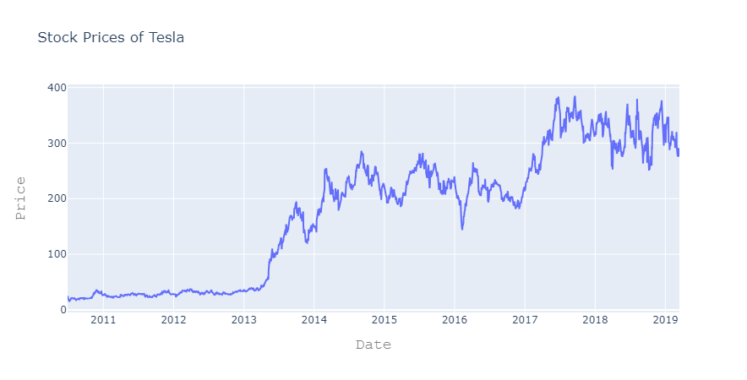
RESULT
Tesla Stock Prices Prediction:

Slide 10
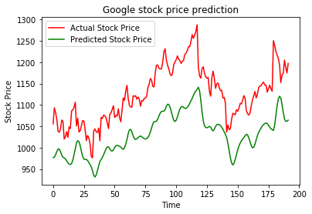
RESULT
Google stock price prediction:

Slide 11
CONCLUSION
We can see the Prediction, analysis and Visualization of Google stock Price hough applying Deep learning algorithms such as LSTM, DENSE, DROP OUT and SEQUENTIAL.
Same way we can use any company Stock Dataset directly apply this algorithms it will give us the correct prediction.
This System is Successfully runs on any system even on Cloud platforms.

Slide 12
FUTURE WORK
Machine Learning and Data science is a game changer in this domain so there is a lot of data to find patterns in for predicting with high degree of accuracy.
In future we will try to predict the values based on multiple factors such as politics, global economic conditions, unexpected events like covid, companies financial performance, and so on.
Decided to implement a simple User Interface to operate this whole process for users so to make people engage in Stock market.

Slide 13
REFRENCES
Fischer, T., & Krauss, C. (2018). Deep learning with long short-term memory networks for financial market predictions. European Journal of Operational Research, 270(2), 654-669.
Patel, J., Shah, S., Thakkar, (2015). Predicting stock market index using fusion of machine learning techniques. Expert Systems with Applications, 42(4), 2162-2172.
Brownlee, J. (2018). Introduction to Time Series Forecasting with Python: How to Prepare Data and Develop Models to Predict the Future. Machine Learning Mastery.
Towards Data Science articles on stock market prediction using machine learning.
T say, R. S. (2010). Analysis of Financial Time Series.

